Slide 1
Relationship between AI, ML, and Deep Learning
Chapter 1 – Lecture 2
Hongjun (Jack) Wu

Slide 2
What Is Artificial Intelligence Anyways?
Artificial Intelligence
The discussion of ‘Artificial Intelligence’ started in the 1950s. The aim is to let machine think and learn like a human.
The famous man Alan Turing invented the ‘Turing Testing’ for identifying if the machine has artificial intelligence by talking(or texting) via phone to a human.
AI: “blah blah blah blah hey I am a human!”
Human: “I think he is indeed a human!”

Slide 3
What Is Artificial Intelligence Anyways?
Categorize Artificial Intelligence
John Searle says there are two types of AI:
Strong AI: AI has same intelligence as human.
Weak AI: AI does not need to have same intelligence as human, as long as it is designed in a way that it looks like it has intelligence.

Slide 4

What is Machine Learning Then?

Slide 5
“Machine Learning is just a branch of Artificial Intelligence!”

Slide 6
“Machine Learning uses algorisms, train a model using the algorism using a lot of data, and when there is a set of new data, we can make prediction using the model we made previously.”

Slide 7
Machine Learning
Supervised Learning
Unsupervised Learning
Reinforcement Learning
There are many uses of machine learning, for example, recommend machine, better ads, junk mail filtering, etc.

Slide 8
Now!
What is Deep Learning?

Slide 9
Deep Learning is just another branch of Machine Learning!

Slide 10
Stuff in deep learning…
Don’t panic! We will cover them later! (Otherwise this course won’t exist!)
Multi-Layer Perception
DNN (Deep Neural Network)
CNN (Convolutional Neural Network)
RNN (Recurrent Neural Network)

Slide 11
Make it visual…
Artificial Intelligence
Machine Learning
Deep Learning

Slide 12
Optional Material
Why all in the sudden Machine Learning developed so rapidly?

Slide 13
Actually…
Scientists developed the algorisms in the 1960s.
But they failed due to lack of computing power.

Slide 14
These helped a lot…
Big Data
Now you have more data than ever! (Mostly generated by your smartphone…) Also, data can be stored in different places, as well as storage is getting cheaper and cheaper over the years.
Graphics Process Unit
GPU helps accelerate the process of training models due to they have MUCH more computing units than CPU. NVIDIA cards are best for training ML models.
(Tell your mom to buy you a brand new NVIDIA RTX 2080 for Christmas because you want to study ML not play Overwatch)

Slide 15
END

Slide 16
1.
Transition headline
Let’s start with the first set of slides

Slide 17
“Quotations are commonly printed as a means of inspiration and to invoke philosophical thoughts from the reader”

Slide 18
This is a slide title
Here you have a list of items
And some text
But remember not to overload your slides with content
Your audience will listen to you or read the content, but won’t do both.

Slide 19
Big concept
Bring the attention of your audience over a key concept using icons or illustrations

Slide 20
You can also split your content
White
Is the color of milk and fresh snow, the color produced by the combination of all the colors of the visible spectrum.
Black
Is the color of coal, ebony, and of outer space. It is the darkest color, the result of the absence of or complete absorption of light.

Slide 21
In two or three columns
Yellow
Is the color of gold, butter and ripe lemons. In the spectrum of visible light, yellow is found between green and orange.
Blue
Is the colour of the clear sky and the deep sea. It is located between violet and green on the optical spectrum.
Red
Is the color of blood, and because of this it has historically been associated with sacrifice, danger and courage.

Slide 22
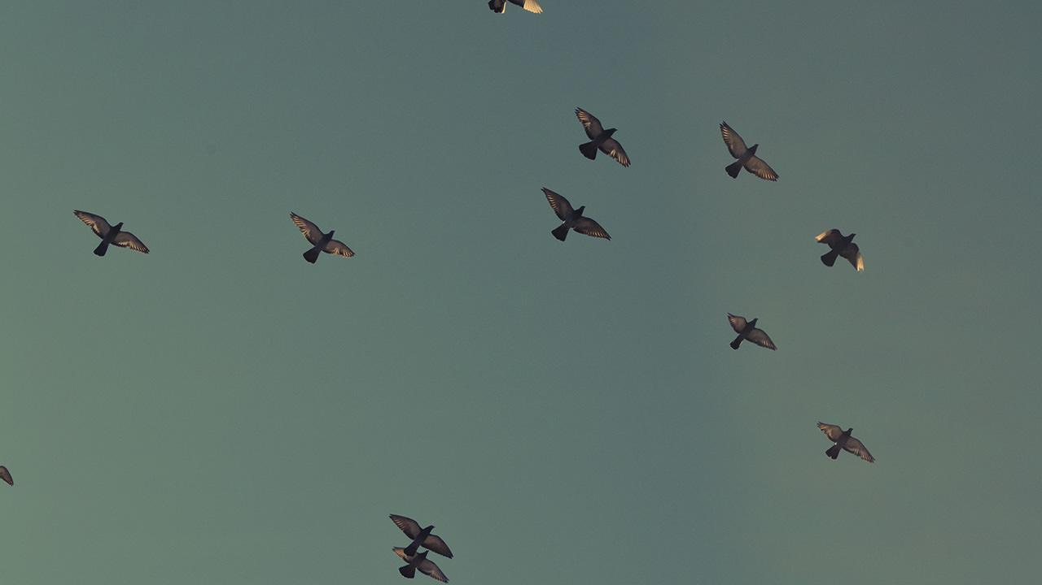
A picture is worth a thousand words
A complex idea can be conveyed with just a single still image, namely making it possible to absorb large amounts of data quickly.

Slide 23
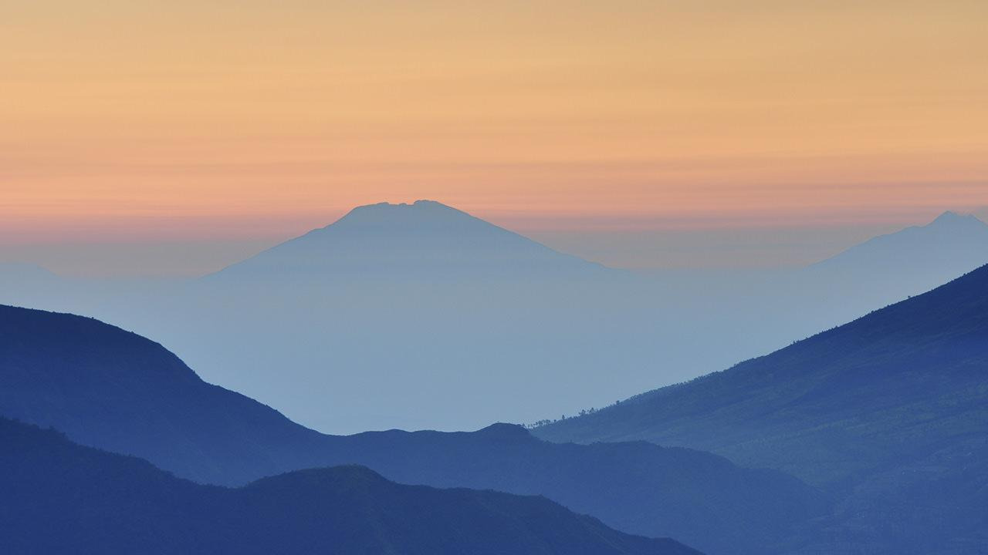
Want big impact?
Use big image.

Slide 24
Use charts to explain your ideas
White
Gray
Black

Slide 25
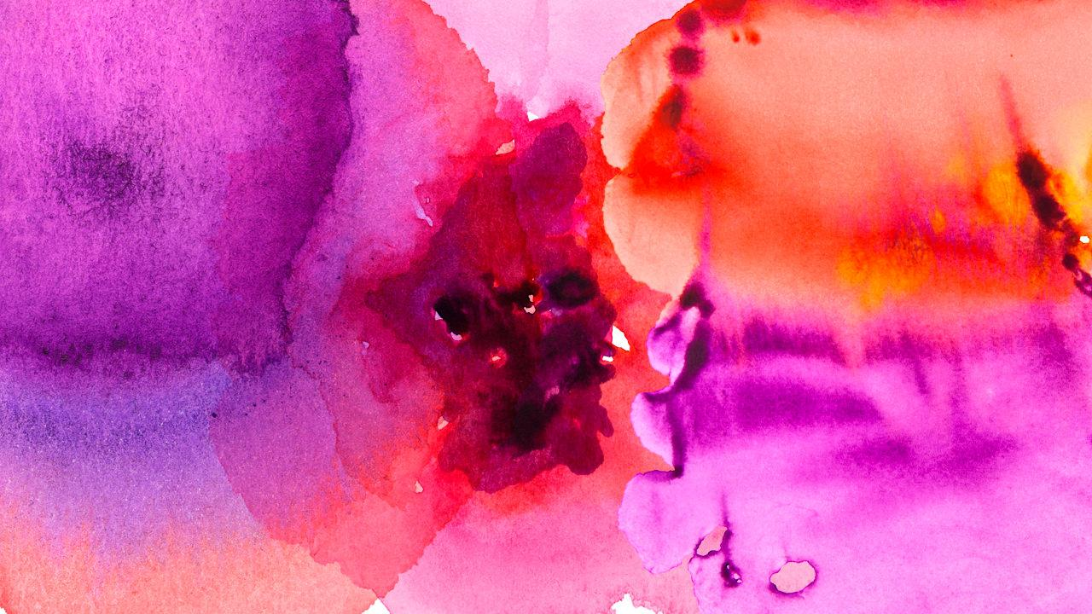
And tables to compare data
 | A | B | C
Yellow | 10 | 20 | 7
Blue | 30 | 15 | 10
Orange | 5 | 24 | 16

Slide 26
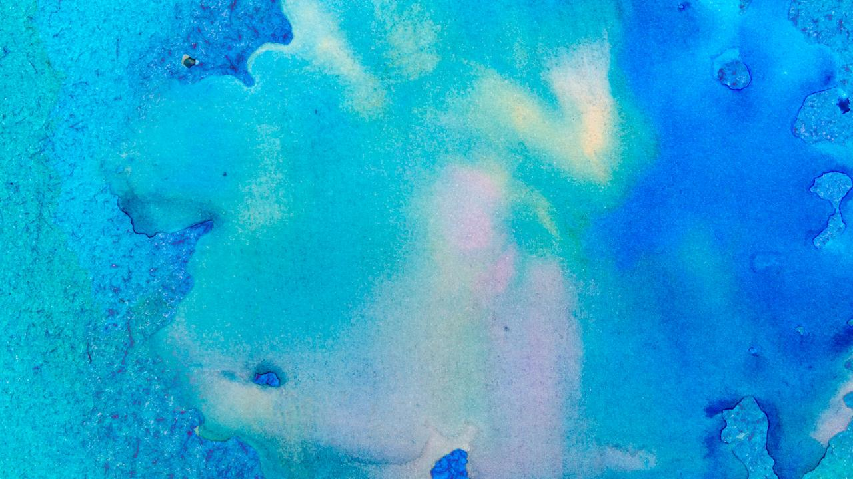
Maps
our office

Slide 27
89,526,124
Whoa! That’s a big number, aren’t you proud?

Slide 28
89,526,124$
185,244 users
100%
That’s a lot of money
And a lot of users
Total success!

Slide 29
Our process is easy
first
second
last

Slide 30
Let’s review some concepts
Yellow
Is the color of gold, butter and ripe lemons. In the spectrum of visible light, yellow is found between green and orange.
Blue
Is the colour of the clear sky and the deep sea. It is located between violet and green on the optical spectrum.
Red
Is the color of blood, and because of this it has historically been associated with sacrifice, danger and courage.
Yellow
Is the color of gold, butter and ripe lemons. In the spectrum of visible light, yellow is found between green and orange.
Blue
Is the colour of the clear sky and the deep sea. It is located between violet and green on the optical spectrum.
Red
Is the color of blood, and because of this it has historically been associated with sacrifice, danger and courage.

Slide 31
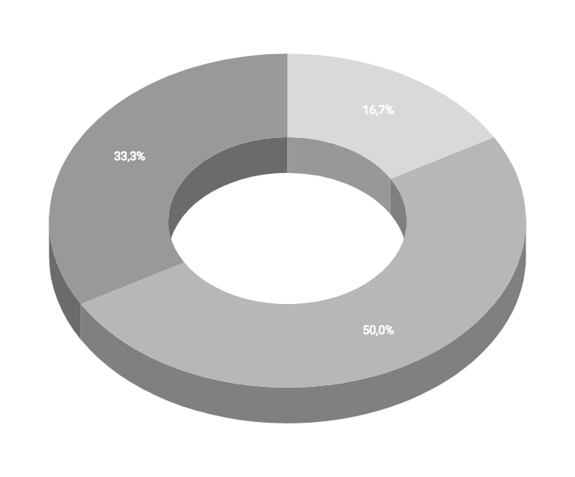
You can insert graphs from Google Sheets

Slide 32
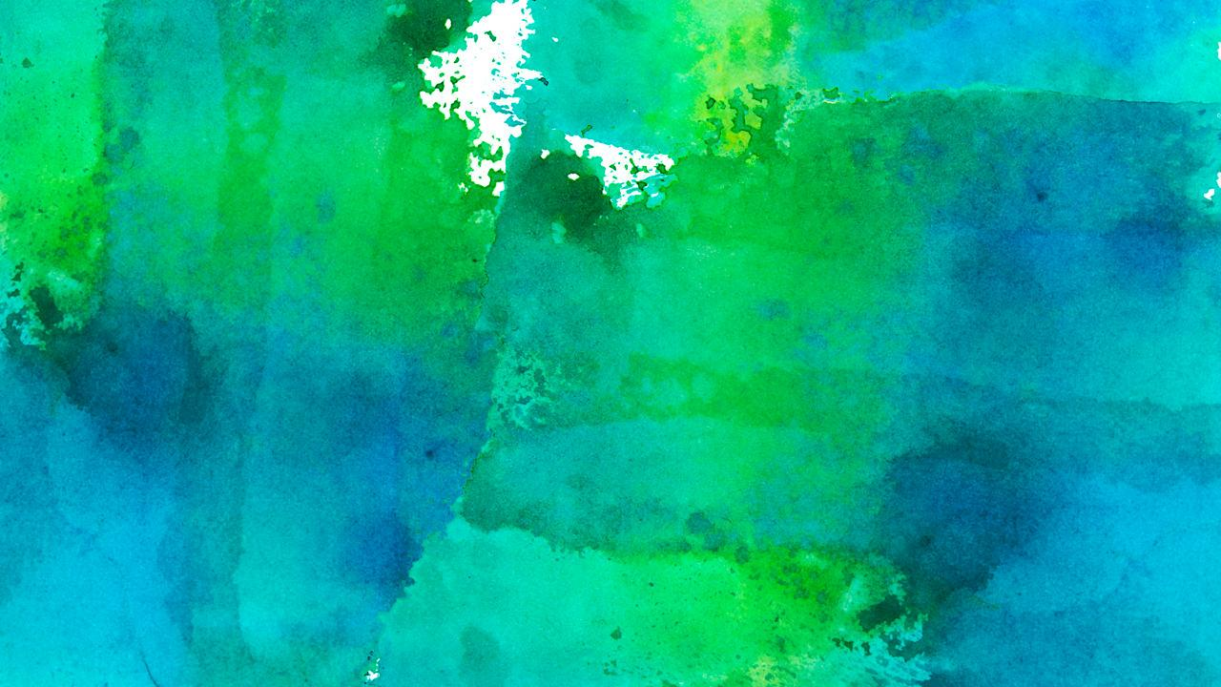
Android project
Show and explain your web, app or software projects using these gadget templates.
Place your screenshot here

Slide 33
iPhone project
Show and explain your web, app or software projects using these gadget templates.
Place your screenshot here

Slide 34
Tablet project
Show and explain your web, app or software projects using these gadget templates.
Place your screenshot here

Slide 35
Desktop project
Show and explain your web, app or software projects using these gadget templates.
Place your screenshot here

Slide 36
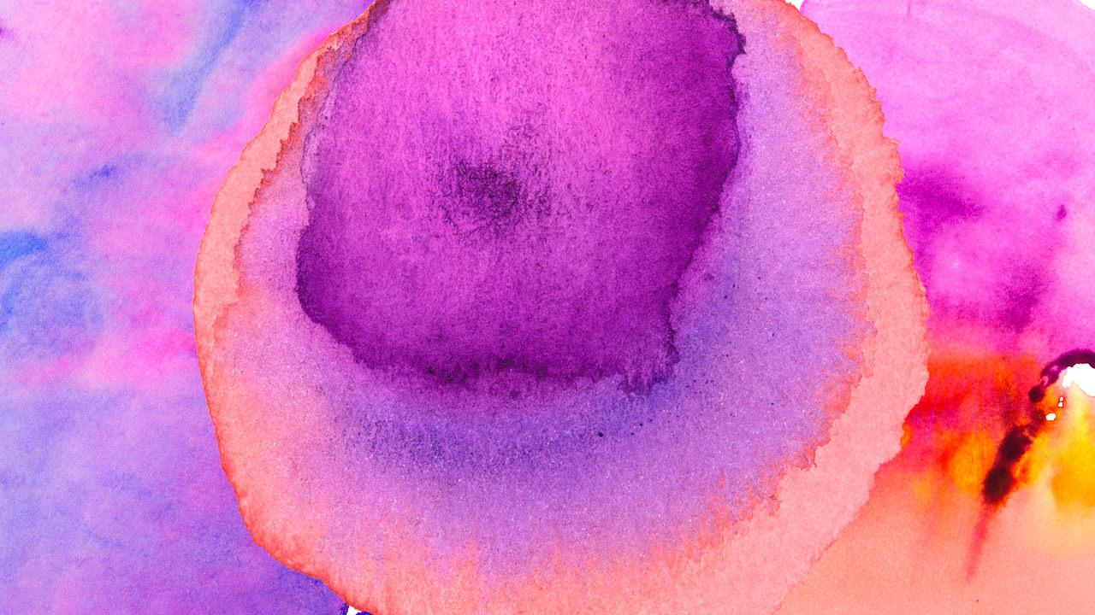
Thanks!
Any questions?
You can find me at:
@username
user@mail.me

Slide 37
Credits
Special thanks to all the people who made and released these awesome resources for free:
Presentation template by SlidesCarnival
Photographs by Unsplash
Watercolor textures by GraphicBurguer

Slide 38
Presentation design
This presentation uses the following typographies and colors:
Titles: Lato Thin
Body copy: Lato Light
You can download the fonts on this page:
http://www.latofonts.com/lato-free-fonts/
You don’t need to keep this slide in your presentation. It’s only here to serve you as a design guide if you need to create new slides or download the fonts to edit the presentation in PowerPoint®

Slide 39
SlidesCarnival icons are editable shapes.
This means that you can:
Resize them without losing quality.
Change fill color and opacity.
Isn’t that nice? :)
Examples:

Slide 40
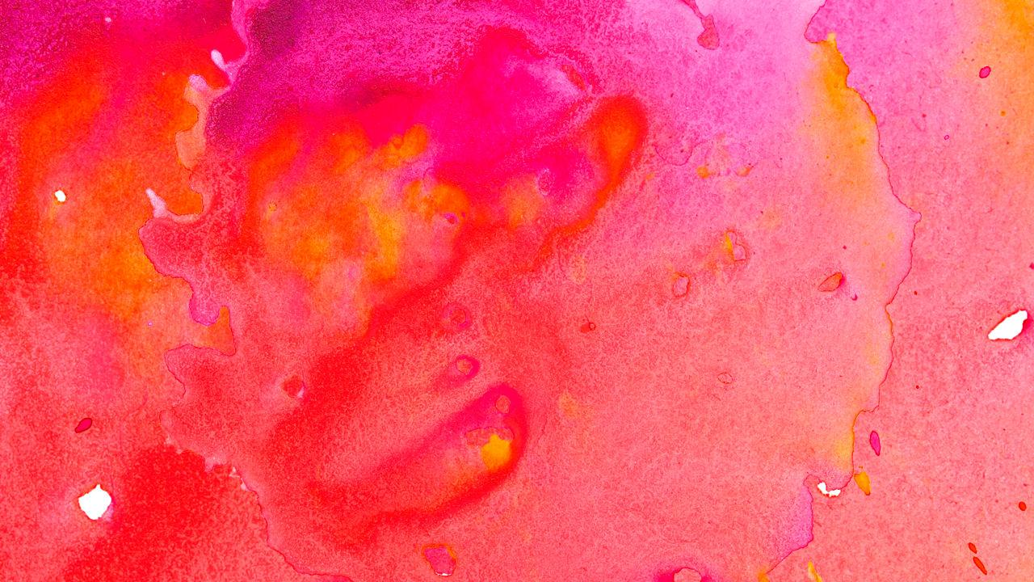
😉
Now you can use any emoji as an icon!
And of course it resizes without losing quality and you can change the color.
How? Follow Google instructions https://twitter.com/googledocs/status/730087240156643328
✋👆👉👍👤👦👧👨👩👪💃🏃💑❤😂😉😋😒😭👶😸🐟🍒🍔💣📌📖🔨🎃🎈🎨🏈🏰🌏🔌🔑 and many more...

